Slide 1
Pandas基础知识
Tom Guo Oct. 2020

Slide 2

Pandas基础知识：
Pandas：python+data+analysis
https://pandas.pydata.org/
https://www.pypandas.cn/

Slide 3
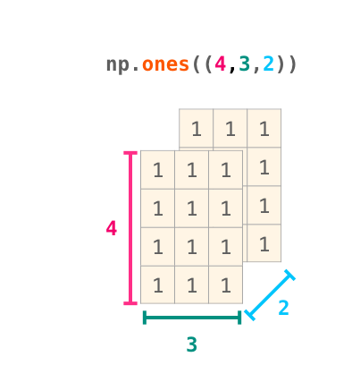
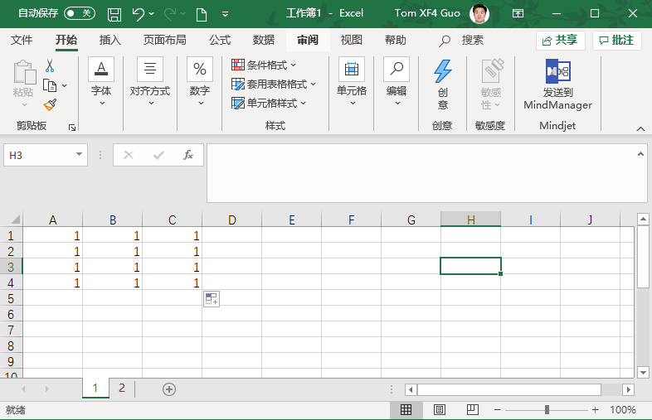
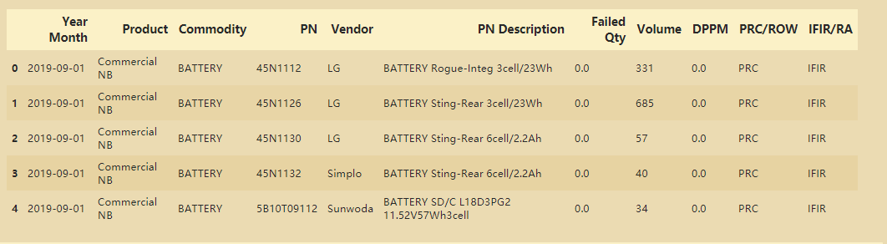
NumPy的核心功能
import pandas as pd
NumPy
Excel
DataFrame

Slide 4
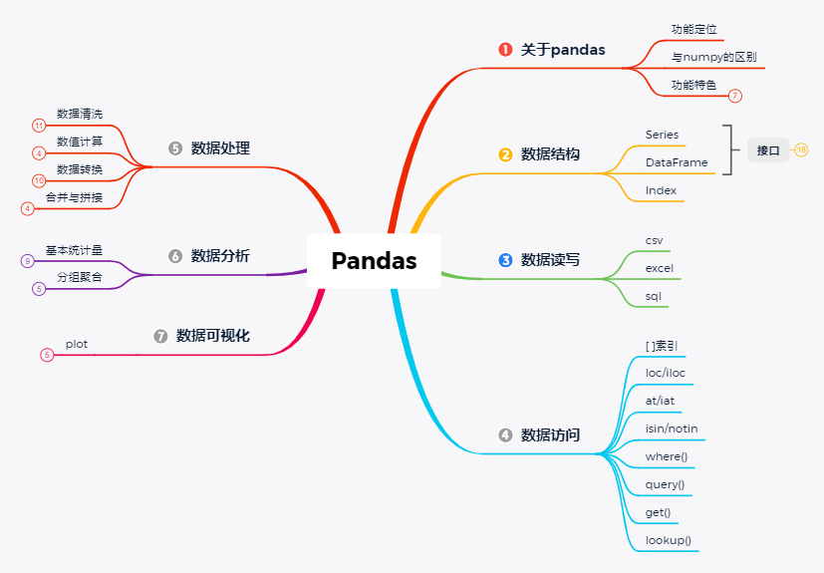
Pandas功能架构
目标：
1）定性自己遇到的问题；
2）恰当的语言描述问题；
3）网上搜索；
https://blog.csdn.net/lemonbit/article/details/106964657

Slide 5
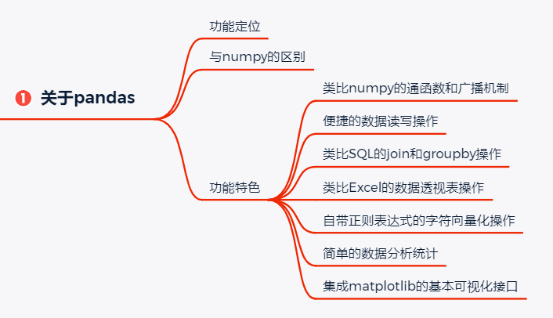
Pandas概览

Slide 6
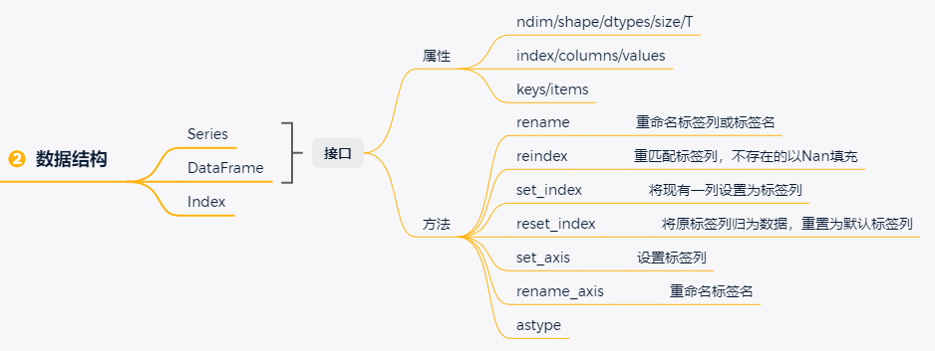
Pandas概览

Slide 7
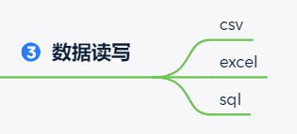
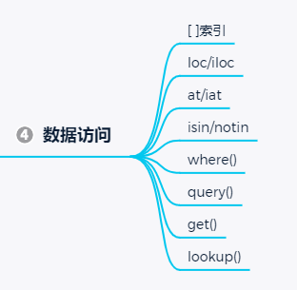
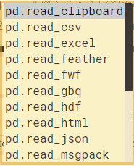
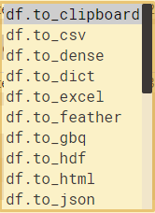
Pandas概览

Slide 8
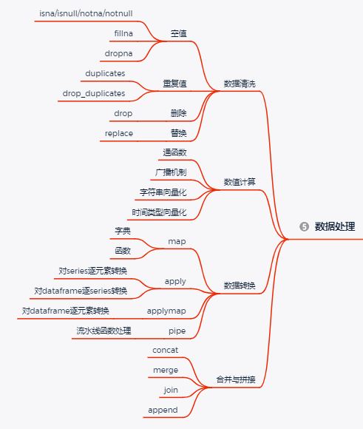

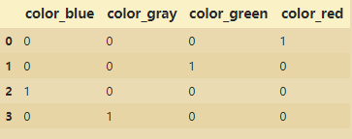
Pandas概览
One hot 编码
pd.get_dummies(df)
归一化
df.transform(lambda: x:(x-x.mean())/x.std())

Slide 9
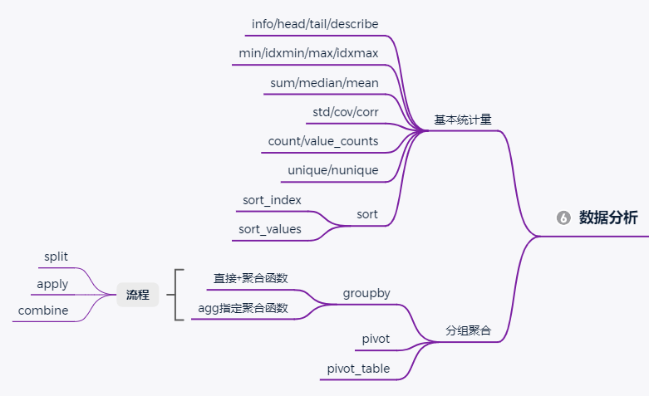
Pandas概览

Slide 10
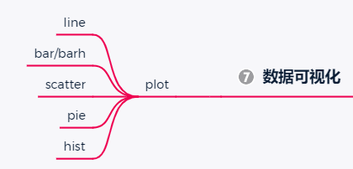
Pandas概览
通常与matplotlib，seaborn等可视化工具包联用，效果更佳！

Slide 11
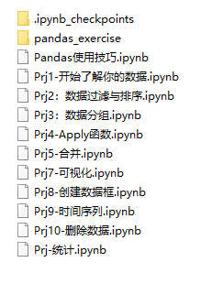
参考资料

Slide 12
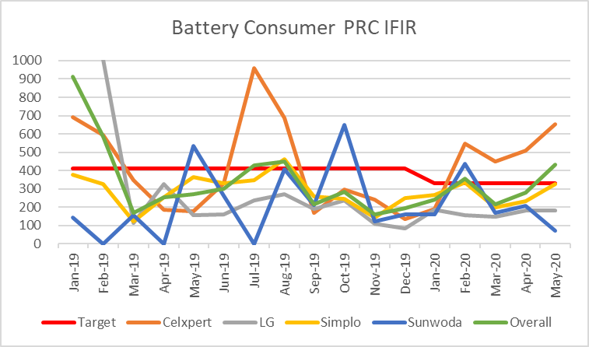
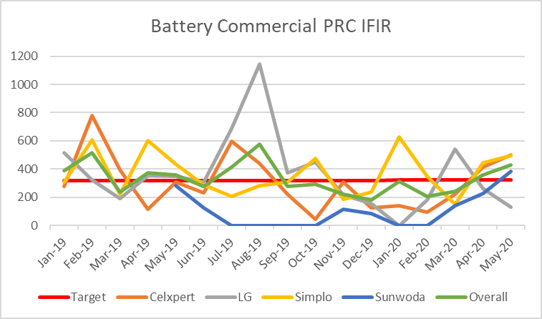
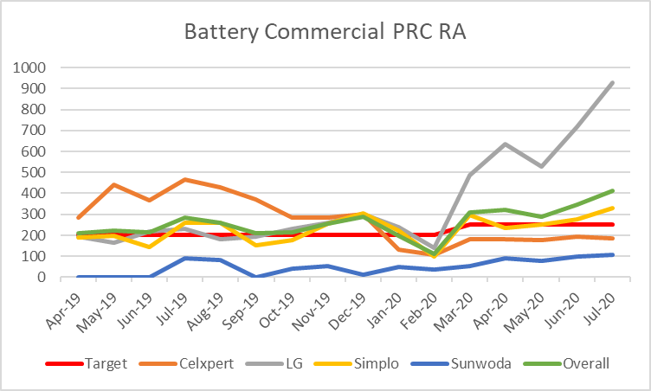
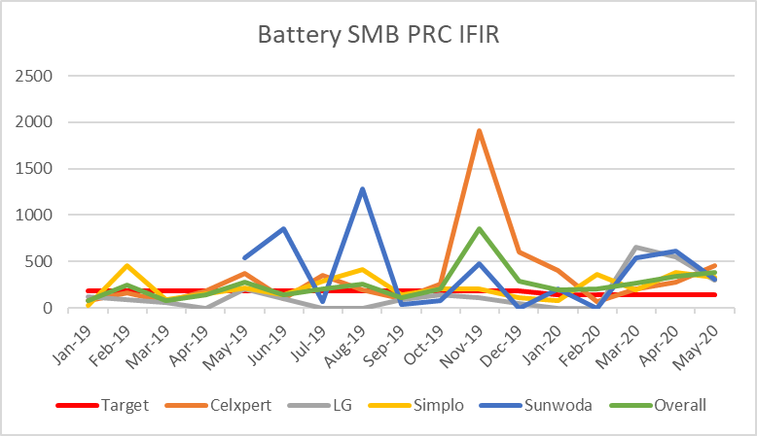
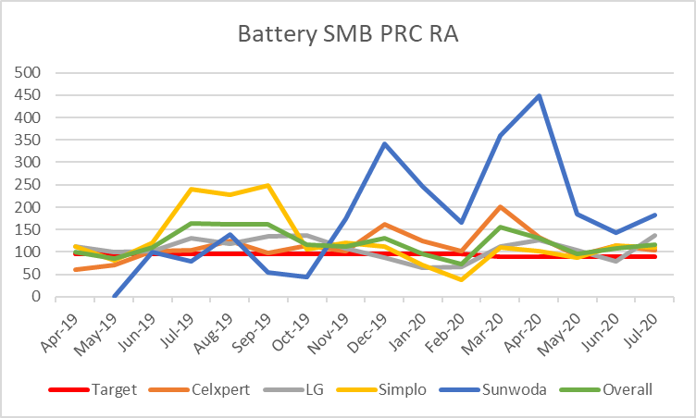
案例：battery KPI data processing
Meet target
Miss target within 5%
Miss target over 5%
No Available/No Volume
Consumer
Commodity /Vendor | PRC IFIR | ROW IFIR | PRC RA | ROW RA
Celxpert | 652 | 320 | 199 | 193
LG | 184 | 211 | 141 | 145
Simplo | 326 | 315 | 112 | 166
Sunwoda | 73 | 272 | 100 | 102
Overall | 432 | 291 | 136 | 167
NB Battery Tgt. | 330 | 305 | 240 | 170
Commercial
Commodity /Vendor | PRC IFIR | ROW IFIR | PRC RA | ROW RA
Celxpert | 498 | 122 | 186 | 97
LG | 132 | 324 | 928 | 215
Simplo | 495 | 192 | 328 | 163
Sunwoda | 381 | 34 | 107 | 35
Overall | 429 | 209 | 413 | 161
NB Battery Tgt. | 325 | 430 | 250 | 250
SMB
Commodity /Vendor | PRC IFIR | ROW IFIR | PRC RA | ROW RA
Celxpert | 451 | 255 | 103 | 81
LG | 301 | 203 | 136 | 43
Simplo | 327 | 271 | 111 | 123
Sunwoda | 310 | 100 | 182 | 104
Overall | 380 | 246 | 116 | 80
NB Battery Tgt. | 145 | 280 | 90 | 80

Slide 13
